Slide 1
Desktop Application
Billing Software

Slide 2
Libraries Used
from tkinter import *
"for styling purpose" from tkinter import ttk
from PIL import Image,ImageTk
from tkinter import messagebox(for messagebox)
'TO GENERATE RANDOM BILL NUMBER' import random,os ‘
To print bill' import tempfile

Slide 3
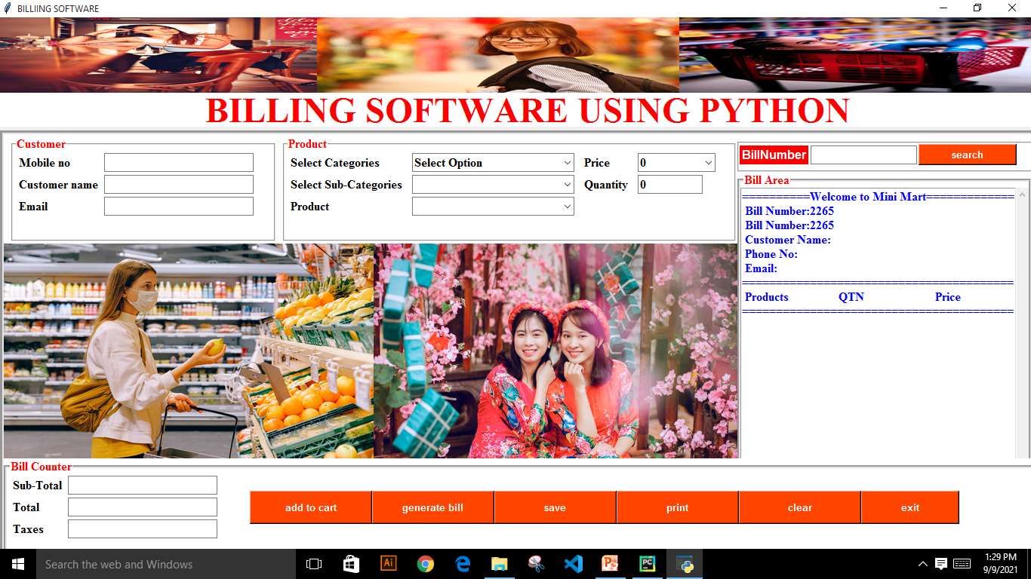
BASIC STRUCTURE

Slide 4
FRAMES
I used one main frame and inside that one mainframe I structured subframes which are as following:
Customer Frame
Product Frame
Search Bill Frame
Text Area Frame
Images Frame
Bill Counter Frame

Slide 5
Variables
self.customername=StringVar() self.customerphone=StringVar() self.billno=StringVar() z=random.randint(1000,9999) self.billno.set(z) self.customeremail=StringVar() self.searchbill=StringVar() self.product=StringVar() self.prices=IntVar() self.subtotal=StringVar() self.taxinp=StringVar() self.totaly=StringVar() self.qty=IntVar()
I have used class so this self helps to call our variable anywhere inside the class.
Each variable is assigned to entry so whenever entry is filled that input is saved inside the variable and we can call it anywhere.

Slide 6
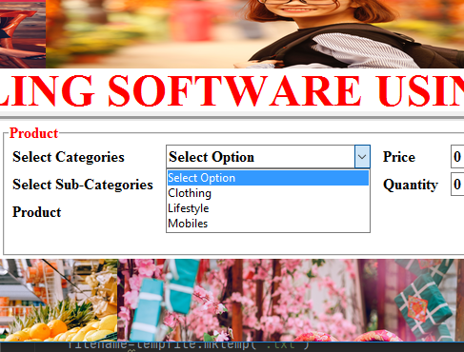
Combo Box
Combo box entry is just like the simple entry its just entry with dropdown options to select and we set current entry with ,current .
self.Combo_subcategory.current ( 0 )
0 is a list position, every category and sub-category is assigned a list.

Slide 7
Basic Idea of Product Section
All sections are just simple entry saving inside variables we assigned.
Basic idea of product section is we make a list of categories(self.Category=['Select Option',"Clothing",'Lifestyle','Mobiles'])
Now clothing category have a list of its sub-cat followed by its price self.subcatcloth=['Pant','Shirt','T-shirt'] ,similarly other categories are assigned as above with their respective sub-cat.

Slide 8
Basic Idea of Product Section
Now sub-cat list holds another list of product brand for eg self.pant=['Levis','Denim','Denizen'] followed by their price to set price .
'Levis Price' self.levispant_price=5000 'Denim Price' self.denimpant_price = 6000 'Denizen Price' self.denizenpant_price = 3500
Similar for other categories and their subcategories and their brand.

Slide 9
.bind
Now category,sub-cat,product,price,quantity are being assigned a function which is working as a binder.
In Simple Words, whenever we select a category for eg, Clothing, its sub-cat list binds inside sub-cat combo-box and whenever we select sub-cat its product brand binds inside product combo and their price set binds inside price combo-box.(All this is performed by their respective functions each function is binded by using .bind).
self.Combo_category.bind("<<ComboboxSelected>>",self.Categories)
self.Combo_subcategory.bind("<<ComboboxSelected>>",self.add)
self.Combo_PRO.bind("<<ComboboxSelected>>",self.price)

Slide 10
Buttons And Func
Add to cart(holds def Additems(self): when all the cat,subcat and their products are binded with price and qty when we click add to cart it adds product to text area).
Welcome(For static welcome text inside text area def Welcome(self):)
Generatebill( holds def genbill(self): after adding to cart when we click it will generate bill with subtotal,taxes,total with our products and their price and quantity.

Slide 11
Buttons And Func
Savebill(holds def savebill(self): save bill inside desied foldr set inside function with a message boxes before saving and after saving.
Printbill(holds def printbill(self): prints the bill)
Clear just clear the application input we set all variables empty inside it.
Exit
Searchbill(holds def findbill(self): search bill inside the folder we save through iteration with a split function if i.split('.')[0] for eg bill saved named as 1238.txt so it will split the filename with ‘.’ And make it as a list so before ‘.’ Is 0 index and after ‘.’ Is index 1.

Slide 12
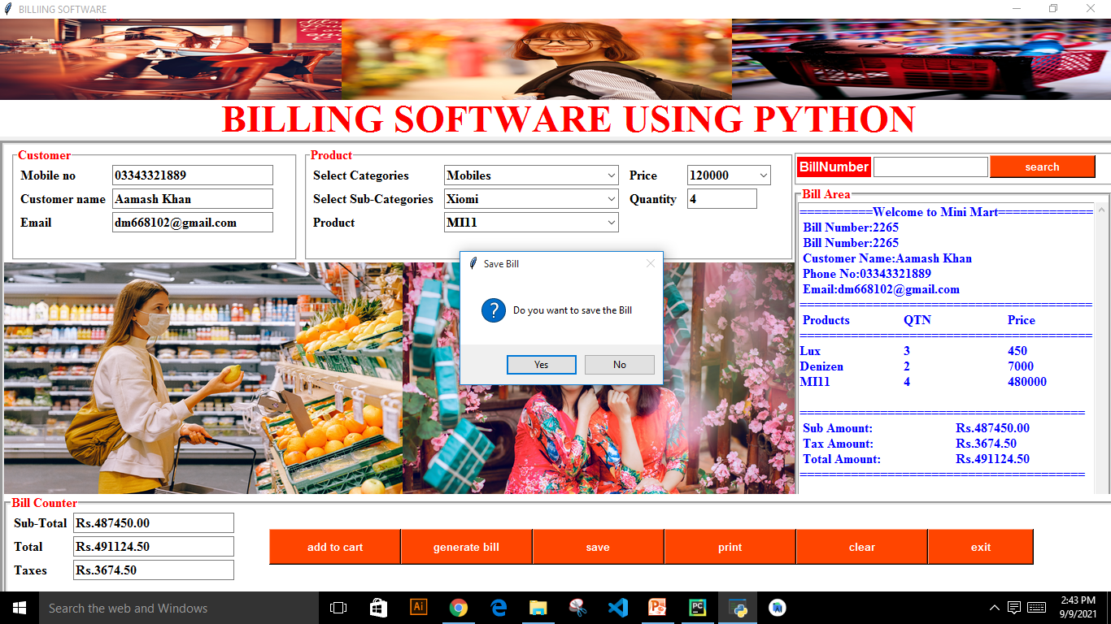

Slide 13
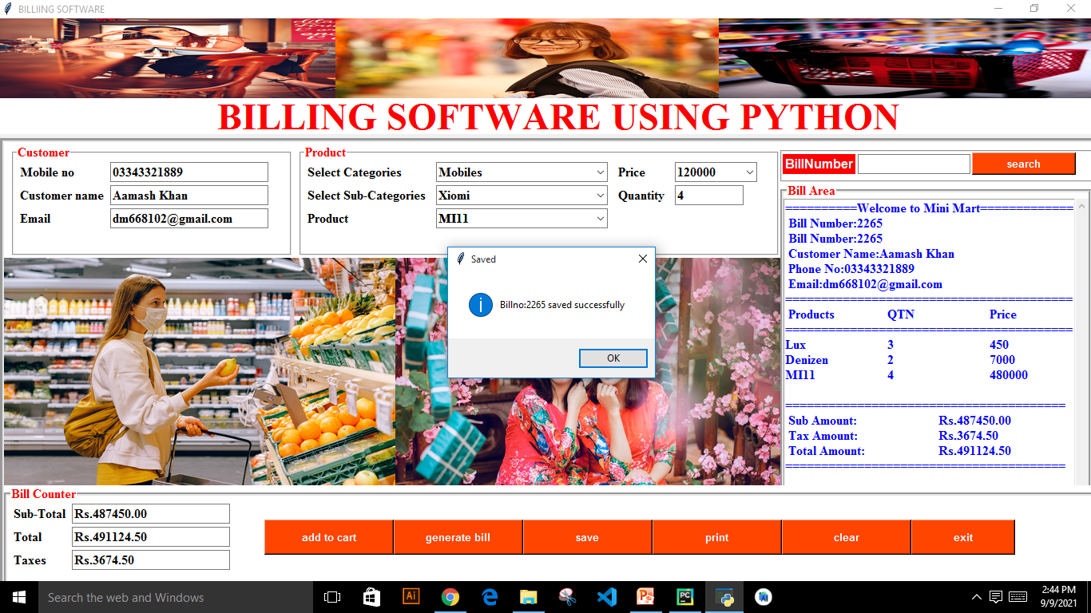

Slide 14
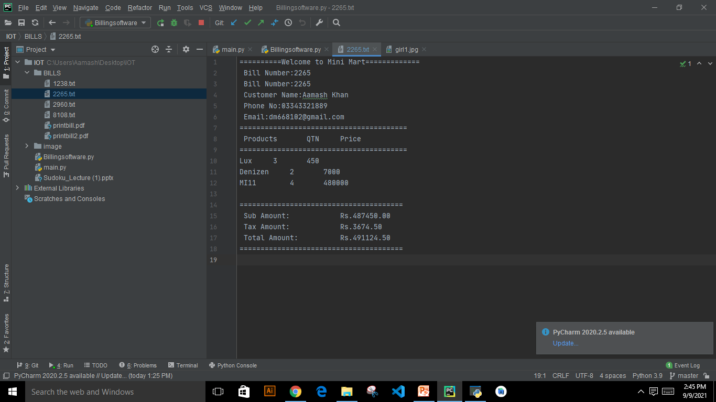

Slide 15
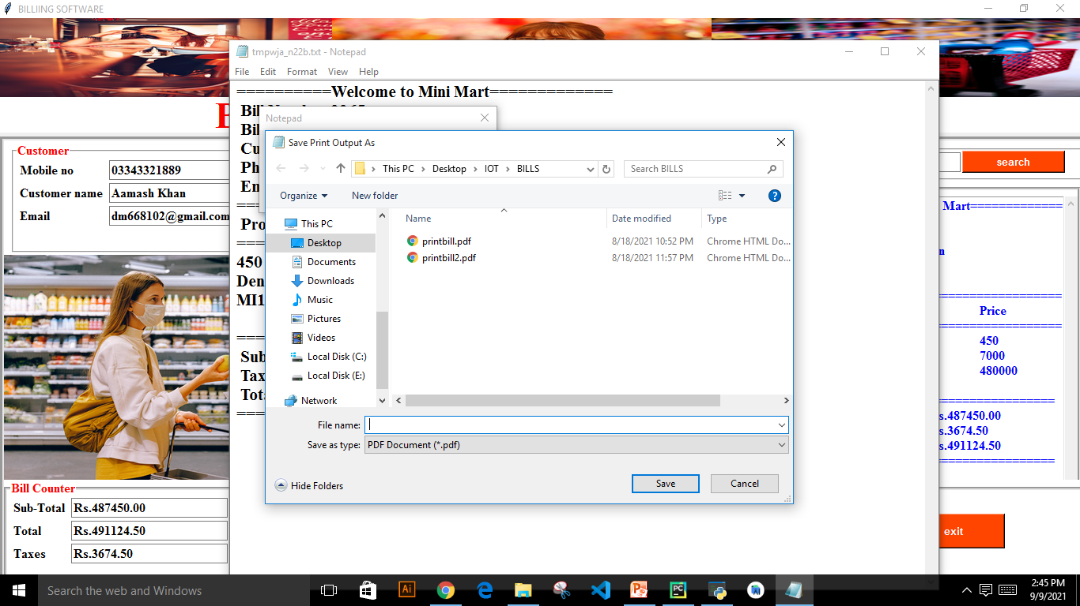

Slide 16


Slide 17
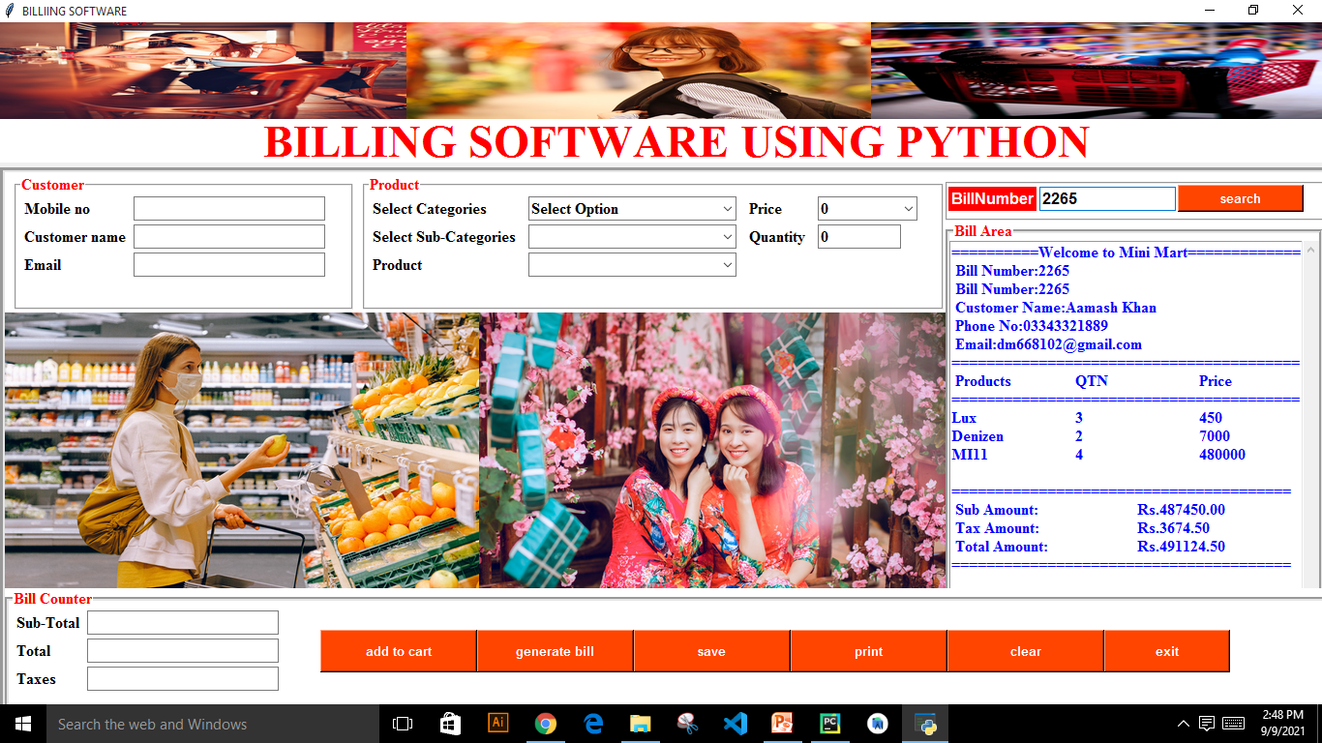

Slide 18
